Slide 1
Module 4
Implementing a Group Policy Infrastructure
Notes:
Presentation: 80 minutes
Lab: 90 minutes
After completing this module, students will be able to:
Explain what Group Policy is.
Implement and administer Group Policy Objects (GPOs).
Manage Group Policy scope and Group Policy processing.
Troubleshoot the application of GPOs.
Required materials
To teach this module, you need the Microsoft® Office PowerPoint® file 20411D_04.pptx.
Important: We recommend that you use PowerPoint 2007 or a newer version to display the slides for this course. If you use PowerPoint Viewer or an older version of PowerPoint, all the features of the slides might not display correctly.
Preparation tasks
To prepare for this module:
Read all of the materials for this module.
Practice performing the demonstrations.
Practice performing the labs.
Work through the Module Review and Takeaways section, and determine how you will use this section to reinforce student learning and promote knowledge transfer to on-the-job performance.
As you prepare for this class, it is imperative that you complete the labs yourself so that you understand how they work and the concepts that are covered in each. This will allow you to provide meaningful hints to students who might get stuck in a lab, and it also will help guide your lecture to ensure that you cover the concepts that the labs cover.
20411D
4: Implementing a Group Policy Infrastructure

Slide 2
Module Overview
Introducing Group Policy Implementing and Administering GPOs Group Policy Scope and Group Policy Processing Troubleshooting the Application of GPOs
Notes:
Introduce the core components and functionality of the Group Policy infrastructure. Prepare students for managing GPOs, GPO links, and GPO processing.
20411D
4: Implementing a Group Policy Infrastructure

Slide 3
Lesson 1: Introducing Group Policy
What Is Configuration Management? Overview of Group Policies Benefits of Using Group Policy Group Policy Objects GPO Scope Group Policy Client and Client-Side Extensions Demonstration: How to Create a GPO and Configure GPO Settings
Notes:
In this lesson, you will provide an overview of Group Policy. The goal of this lesson is to introduce the core concepts, terms, and components of Group Policy. Students must see the overview, and have a feeling for the pieces and how they fit together.
Do not go into too much detail about any one concept, term, or component. Remaining lessons in this module provide greater detail about each concept, term, and component. Some students might be familiar with some of this content, particularly those who have recently attended course 20410, “Installing and Configuring Windows Server 2012.” If this is the case, use the lesson as a review.
We highly recommend that you read the text in the student handbook for this lesson, and use that text as a guide or even as a script for delivering this module. The text provides just enough detail to get students on the same page, regardless of their previous experience levels.
We also highly recommended that, rather than stepping through slides, you demonstrate as much as possible in the user interface as you discuss policy settings, GPOs, and GPO links. Again, the text in the student handbook provides a guide for this demonstration. You can use the policy setting that restricts access to the registry tools, and then follow that through a GPO, linking the GPO to an organizational unit (OU), and then perhaps even showing the results of the GPO on a client.
Consider starting the lesson with the demonstration “How to Create a GPO and Configure GPO Settings” that appears at the end of this lesson. Use that as the basis for talking through the content on this lesson’s topics.
20411D
4: Implementing a Group Policy Infrastructure

Slide 4
What Is Configuration Management?
Configuration management is a centralized approach to applying one or more changes to one or more users or computers
The key elements of configuration management are:
Setting
Scope
Application
Notes:
Because there are so many components within Group Policy, it is helpful to start by taking a step back from the technology. Make sure that students understand the broad concept and business value of configuration management. Present configuration management as three elements: setting, scope, and application. This creates a framework in students’ minds for the role of each Group Policy component.
Explain that configuration management in general, and Group Policy in particular, enable information technology (IT) administrators to automate the management of users and computers. This simplifies administrative tasks and reduces IT costs. Administrators can implement security settings, enforce IT policies, and distribute software consistently for local computers or across a given site, domain, or range of OUs. Configuration management is one of the Information Assurance topics that builds the case for GPO usage. This is an industry best practice that requires emphasis. Resultant Set of Policy (RSoP) also is good documentation for the standardization of computers and user accounts. Furthermore, this is a good place to mention how an organization’s security posture improves with the effective use of Group Policy. GPOs also are a method for mitigating the risks associated with specific security threats to organizations.
20411D
4: Implementing a Group Policy Infrastructure

Slide 5
Overview of Group Policies
The most granular component of Group Policy is known as a policy and defines a specific configuration change
Most policy settings can have three states:
Not Configured
Enabled
Disabled
Many policy settings are complex, and the effect of enabling or disabling them might not be obvious
Notes:
Consider demonstrating the Group Policy Management Editor on LON-DC1 while you discuss this and subsequent topics.
20411D
4: Implementing a Group Policy Infrastructure

Slide 6
Benefits of Using Group Policy
GPOs are very powerful administrative tools and you can use them to enforce various types of settings to a large number of users and computers
Typically, GPOs are used in the following way:
Apply security settings
Manage desktop application settings
Deploy application software
Manage Folder Redirection
Configure network settings
Notes:
Consider demonstrating some of the settings that the slide lists.
20411D
4: Implementing a Group Policy Infrastructure

Slide 7
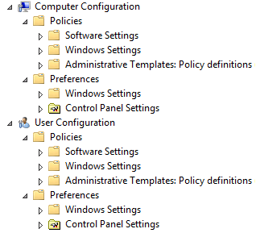
Group Policy Objects
A GPO is:
A container for one or more policy settings
Managed with the GPMC
Stored in the GPOs container
Edited with the Group Policy Management Editor (GPME)
Applied to a specific level in the AD DS hierarchy
Notes:
Consider demonstrating each point in the slide to help reinforce student understanding.
20411D
4: Implementing a Group Policy Infrastructure

Slide 8
GPO Scope
The scope of a GPO is the collection of users and computers that will apply the settings in the GPO.
You can use several methods to scope a GPO:
Link the GPO to a container, such as an OU
Filter by using security settings
Filter by using WMI filters
Notes:
Mention that a GPO, and all of the settings that it contains, does not take effect until you have defined its scope. The first step to scoping a GPO is linking it to a site, domain, or OU. Introduce students to the mnemonic, Site, Domain, or organizational unit.
Stress that GPOs apply to users and computers only, and not to groups, despite the Group Policy name.
If you choose to demonstrate the slide, create a new GPO, and then link it to the domain.
Emphasize the idea that the link or links define the maximum scope of a GPO.
Discussion Prompt
Pose a question: what if you do not want the GPO settings to apply to all objects within the scope?
Use the question to transition to the concept of security group filtering, emphasizing that such filtering creates a subset of objects within the broader scope of the GPO link.
Important Note:
Many experienced students rely too heavily on GPO links to manage the scope of GPOs. This often leads to less-than-ideal design of Active Directory® Domain Services (AD DS) OUs, at the expense of efficiently applied and managed security, such as access control lists (ACLs) and delegation.
Briefly mention that there are additional options for targeting GPOs, such as Windows Management Instrumentation (WMI) filters. An upcoming topic discusses WMI filters. Wrap up with a mention of GPO Preferences targeting. The goal is simply to introduce the term, and to prepare students for the idea that it is possible to apply only part of a GPO to clients as long as that part is part of preferences.
20411D
4: Implementing a Group Policy Infrastructure

Slide 9
Group Policy Client and Client-Side Extensions
Group Policy Client retrieves GPOs
Client downloads and caches GPOs
CSEs process the settings
Policy settings in the Computer Configuration node are applied at system startup and every 90–120 minutes thereafter
User Configuration policy settings are applied at logon and every 90–120 minutes thereafter
Notes:
Use this topic to introduce the concept that Group Policy applies by using client-side, or pull, processes. Introduce students to the idea that there are two major phases to application. First, the Group Policy Client asks AD DS which GPOs to apply. Then, enhanced GPOs go to the client-side extensions (client-side extensions), which actually apply the settings.
Present the fact that most client-side extensions apply settings only if the GPO has changed, which improves performance by not needlessly reapplying the same settings repeatedly. You might choose to discuss the Always Wait For Network At Startup And Logon policy setting as you discuss Group Policy refresh and application. Information about this setting is available in the student handbook.
20411D
4: Implementing a Group Policy Infrastructure

Slide 10
Demonstration: How to Create a GPO and Configure GPO Settings
In this demonstration, you will see how to:
Use the GPMC to create a new GPO
Configure Group Policy settings
Notes:
Leave the virtual machine running for subsequent demonstrations.
Preparation Steps
Start the 20411D-LON-DC1 virtual machine. Demonstration Steps
Use the Group Policy Management Console (GPMC) to create a new GPO
Switch to LON-DC1, and then sign in as Adatum\Administrator with the password Pa$$w0rd.
In Server Manager, click Tools, and then click Group Policy Management.
If necessary, expand Forest: Adatum.com, expand Domains, and then expand Adatum.com.
Select and then right-click the Group Policy Objects folder, and then click New.
In the New GPO dialog box, in the Name field, type Desktop, and then click OK.
Configure Group Policy settings
In Group Policy Management, expand the Group Policy Objects folder, right-click the Desktop policy, and then click Edit.
In the Group Policy Management Editor, under Computer Configuration, expand Policies, expand Windows Settings, expand Security Settings, expand Local Policies, and then click Security Options.
In the details pane, double-click Interactive logon: Do not display last user name.
In the Interactive logon: Do not display last user name Properties dialog box, select the Define this policy setting check box, click Enabled, and then click OK.
Under the Security Settings node, click System Services.
In the details pane, double-click Windows Installer.
In the Windows Installer Properties dialog box, select the Define this policy setting check box, and then click OK.
20411D
4: Implementing a Group Policy Infrastructure
(More notes on the next slide)

Slide 11
Notes:
Under User Configuration, expand Policies, expand Administrative Templates, and then click Start Menu and Taskbar.
In the details pane, double-click Remove Search link from Start Menu.
In the Remove Search link from Start Menu dialog box, click Enabled, and then click OK.
Under the Administrative Templates folder, expand Control Panel, and then click Display.
In the details pane, double-click Hide Settings tab.
In the Hide Settings tab dialog box, click Enabled, and then click OK.
Close all open windows on LON-DC1.
20411D
4: Implementing a Group Policy Infrastructure

Slide 12
Lesson 2: Implementing and Administering GPOs
Domain-Based GPOs GPO Storage Starter GPOs Common GPO Management Tasks Delegating Administration of Group Policies Managing GPOs with Windows PowerShell
Notes:
In this lesson, you will teach students the fundamentals of implementing Group Policy. Focus on the fundamentals. The next module will build on these basic implementations.
20411D
4: Implementing a Group Policy Infrastructure

Slide 13
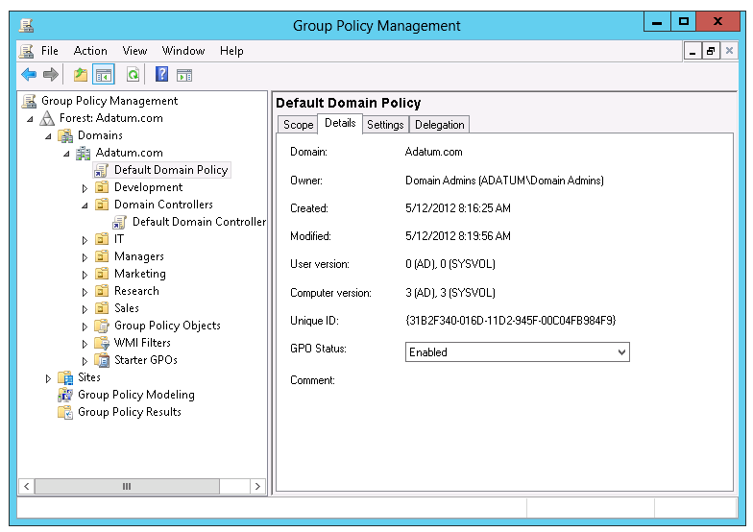
Domain-Based GPOs
Notes:
Explain the purpose of two default domain-based GPOs. Also, tell students that we do not recommend that they change settings in these GPOs. Rather, they should create new ones. Emphasize that Default Domain Controller Policy is used only on domain controllers.
Briefly mention local GPOs, but do not focus on these. Emphasize that domain-based GPOs take precedence because of the processing order.
20411D
4: Implementing a Group Policy Infrastructure

Slide 14
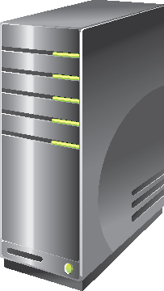


GPO Storage
Group Policy Container
GPO
Stored in AD DS
Provides version information
Group Policy Template
Contains Group Policy settings
Stores content in two locations
Stored in a shared SYSVOL folder
Provides Group Policy settings
Notes:
Consider showing the students the Group Policy template and Group Policy container.
20411D
4: Implementing a Group Policy Infrastructure

Slide 15
Starter GPOs
A Starter GPO:
Stores Administrative Template settings on which the new GPOs will be based
Can be exported to .cab files
Can be imported into other areas of the enterprise
Exported to cab file
Imported to GPMC
StarterGPO
.cab File
Load .cab file
Notes:
Explain that starter GPOs allow you to store preconfigured Administrative Template settings in starter GPOs that act as templates for creating new GPOs. You can export these starter GPOs into .cab files that you easily can import into other areas of your enterprise. This can help provide consistency in large enterprises. You can store comments about the Starter GPO in the template itself.
20411D
4: Implementing a Group Policy Infrastructure

Slide 16
Common GPO Management Tasks
GPMC provides several options for managing the state of GPOs
Backup GPOs
Restore GPOs
Copy GPOs
Import GPOs
Notes:
Like critical data and AD DS–related resources, you must back up GPOs to protect the integrity of AD DS and GPOs. The GPMC not only provides the basic backup and restore options, but it also provides additional control over GPOs for administrative purposes, including that:
You can back up GPOs individually or as a whole with the GPMC or Windows PowerShell®.
The restore interface provides the ability for you to view the settings stored in the backup version before restoring it.
Importing a GPO allows you to transfer settings from a backup GPO to an existing GPO. It does not modify the existing security or links on the destination GPO.
You can copy GPOs by using the GPMC or Windows PowerShell, both in the same domain and across domains.
Demonstration
Consider showing students how to perform these tasks.
20411D
4: Implementing a Group Policy Infrastructure

Slide 17
Delegating Administration of Group Policies
Delegation of GPO-related tasks allows the administrative workload to be distributed across the enterprise
The following Group Policy tasks can be independently delegated:
Creating GPOs
Editing GPOs
Managing Group Policy links for a site, domain, or OU
Performing Group Policy Modeling analysis on a domain or OU
Reading Group Policy Results data in a domain or OU
Creating WMI filters in a domain
Notes:
Explain that you can delegate different aspects of GPO management. Emphasize that the ability to create, link, and edit GPOs are separate events, and that having the right to perform one of those operations does not give you any rights to perform other operations. The administrator is the only user who has the right to perform all of these actions by default.
You can use the Delegation of Control Wizard or the GPMC to delegate linking GPOs and to enable the use of reporting tools. Explain that you can use membership in the Group Policy Creator Owners group or delegation through the GPMC to delegate the right to create new Group Policy. You can configure each individual policy to allow users or groups to edit that policy.
The Group Policy Creator Owners group allows its members to create new GPOs, and to edit or delete the GPOs that they create.
Consider showing students how to perform these tasks.
20411D
4: Implementing a Group Policy Infrastructure

Slide 18
Managing GPOs with Windows PowerShell
In addition to using GPMC and the Group Policy Managemnt Editor, you can also perform common GPO administrative tasks by using Windows PowerShell
Examples:
Create a new GPO called Sales:
New-GPO -Name Sales -comment "This the sales GPO"
Import the settings from the backup Sales GPO in the C:\Backups folder into the NewSales GPO:
import-gpo -BackupGpoName Sales -TargetName NewSales -path c:\backups
Notes:
Walk students through the examples by using the LON-DC1 virtual machine.
20411D
4: Implementing a Group Policy Infrastructure

Slide 19
Lesson 3: Group Policy Scope and Group Policy Processing
GPO Links Demonstration: Linking GPOs Group Policy Processing Order Configuring GPO Inheritance and Precedence Using Security Filtering to Modify Group Scope What Are WMI Filters? Demonstration: Filtering Policies Enable and Disable GPOs and GPO Nodes Loopback Policy Processing Strategies for Slow Links and Disconnected Systems Identifying When Settings Become Effective Considerations For Managing Group Policy In A Multi-Domain Environment
Notes:
20411D
4: Implementing a Group Policy Infrastructure

Slide 20
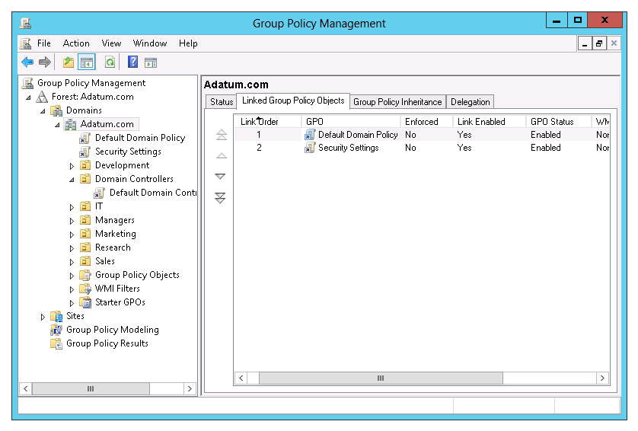
GPO Links
Notes:
The key point of this topic is to explain what you can do with GPO links. It is very important to emphasize that a GPO link actually connects Group Policy settings to a container in AD DS. Also, you should explain the states the link can be in and the differences between those states.
Consider demonstrating each of the activities described in the topic.
20411D
4: Implementing a Group Policy Infrastructure

Slide 21
Demonstration: Linking GPOs
In this demonstration, you will see how to:
Create and link GPOs to different locations
Disable a GPO link
Delete a GPO link
Notes:
Leave the virtual machine running for subsequent demonstrations.
Preparation Steps
The required virtual machine, 20411D-LON-DC1, should be running already after the preceding demonstration.
Demonstration Steps
Create and edit two GPOs
On LON-DC1, if necessary, open Server Manager.
In Server Manager, click Tools, and then click Group Policy Management.
In the Group Policy Management Console, expand Forest: Adatum.com, expand Domains, expand Adatum.com, right-click the Group Policy Objects container, and then click New.
In the New GPO window, type Remove Run Command in the Name field, and then click OK.
In the Group Policy Management window, right-click the Group Policy Objects container, and then click New.
In the New GPO window, type Do Not Remove Run Command in the Name field, and then click OK.
Expand Group Policy Objects, right-click the Remove Run Command GPO, and then click Edit.
In Group Policy Management Editor, under User Configuration, expand Policies, expand Administrative Templates, click Start Menu and Taskbar, and then double-click Remove Run menu from Start Menu.
In the Remove Run menu from Start Menu window, click Enabled, and then click OK.
Close the Group Policy Management Editor.
Right-click the Do Not Remove Run Command GPO, and then click Edit.
In Group Policy Management Editor, under User Configuration, expand Policies, expand Administrative Templates, click Start Menu and Taskbar, and then double-click Remove Run
20411D
4: Implementing a Group Policy Infrastructure
(More notes on the next slide)

Slide 22
Notes:
menu from Start Menu.
In the Remove Run menu from Start Menu window, click Disabled, and then click OK.
Close the Group Policy Management Editor.
Link the GPOs to different locations
In the Group Policy Management window, right-click the Adatum.com domain node in the left pane, and then click Link an Existing GPO.
In the Select GPO window, click Remove Run Command, and then click OK. The Remove Run Command GPO is now attached to the Adatum.com domain.
Click and drag the Do Not Remove Run Command GPO to the IT OU.
In the Group Policy Management window, click OK to link the GPO.
Click the IT OU in the left pane, and then click the Group Policy Inheritance tab in the right pane. The Group Policy Inheritance tab shows the order of precedence for the GPOs.
Disable a GPO link
In the left pane, right-click the Remove Run Command link that is listed under Adatum.com, and then click Link Enabled to clear the check mark. Refresh the Group Policy Inheritance window for the IT OU, and then notice the results in the right pane. The Remove Run Command GPO no longer is listed.
Delete a GPO link
In the left pane, expand the IT OU, right-click the Do Not Remove Run Command link, and then click Delete. Click OK in the pop-up window.
Click the IT OU in the left pane, and then click the Group Policy Inheritance tab in the right pane. Verify the removal of the Do Not Remove Run Command and the absence of the Remove Run Command GPOs.
In the left pane, right-click the Remove Run Command GPO that is listed under Adatum.com, and
(More notes on the next slide)
20411D
4: Implementing a Group Policy Infrastructure

Slide 23
Notes:
then click Link Enabled to re-enable the link. Refresh the Group Policy Inheritance window for the IT OU, and then notice the results in the right pane.
Close the Group Policy Management Console.
20411D
4: Implementing a Group Policy Infrastructure

Slide 24

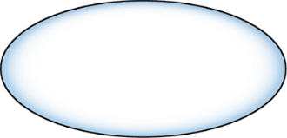
Group Policy Processing Order
GPO1
Local Policy
GPO2
Site
GPO3
Domain
GPO4
OU
GPO5
OU
OU
Notes:
This slide illustrates the Group Policy application order. You can use it to enforce the L-S-D-OU mnemonic.
20411D
4: Implementing a Group Policy Infrastructure

Slide 25
Configuring GPO Inheritance and Precedence
The application of GPOs that are linked to each container results in a cumulative effect called inheritance
Default Precedence: Local → Site → Domain → OU → OU… (LSDOU)
Seen on the Group Policy Inheritance tab
Link order (attribute of GPO Link)
Lower number → Higher on list → Precedent
Block Inheritance (attribute of OU)
Blocks the processing of GPOs from above
Enforced (attribute of GPO link)
Enforced GPOs “blast through” Block Inheritance
Enforced GPO settings win over conflicting settings in lower GPOs
Notes:
As you discuss Group Policy inheritance and precedence, ensure that students understand that what is called inheritance is really just the effect of repeated, layered applications of settings in GPOs in a specific order.
Consider demonstrating this topic’s points by creating GPOs and then enforcing them. It is not necessary to show the effect of the enforcement. Also, demonstrate the procedure for blocking inheritance. Again, merely show the procedure.
20411D
4: Implementing a Group Policy Infrastructure

Slide 26
Using Security Filtering to Modify Group Scope
Apply Group Policy permission
GPO has an ACL (Delegation tab → Advanced)
Default: Authenticated Users have Allow Read and Allow Apply Group Policy
Scope only to users in selected global groups
Remove Authenticated Users
Add appropriate global groups
Must be global groups (GPOs do not scope to domain local)
Scope to users except for those in selected groups
On the Delegation tab, click Advanced
Add appropriate global groups
Deny Apply Group Policy permission
Does not appear on the Delegation tab or in filtering section
Notes:
Many organizations struggle with how to maintain governance over Group Policy—specifically, how to test a GPO effectively before rolling it into production. Talk through a simple and effective best practice: use security group filtering to manage the scope of a GPO during testing. Instead of creating a sub-OU to manage the GPO’s scope for testing, link the GPO to the location to which it belongs in production. Instead of allowing the GPO to apply to Authenticated Users, or to the production security group, configure a security group specifically designed to limit the scope of the GPO to appropriate users and computers. The benefit of this practice is that it gives a much more realistic picture of how the GPO will perform in production, because you are not artificially limiting its scope or precedence by linking it to a separate test OU. In other words, you get a better understanding of how the GPO interacts with other GPOs that are already in production. Yet, you still maintain full control over the specific users and computers that are within the test’s scope.
Tip
If you remove Authenticated Users and then scope a GPO to a specific group, support personnel will not be able to read the policy to perform Group Policy management tasks. Be sure to assign appropriate support personnel Read permission to the GPO, but do not assign them the Apply Group Policy permission.
Demonstration
Consider demonstrating the points raised in this topic as you discuss them.
20411D
4: Implementing a Group Policy Infrastructure

Slide 27
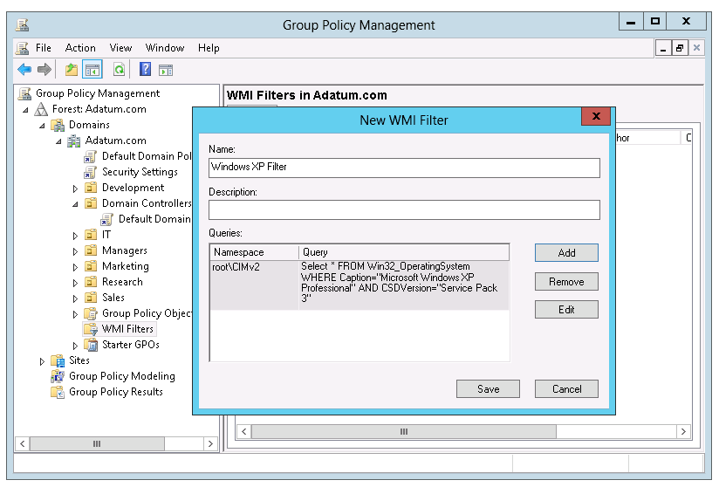
What Are WMI Filters?
Notes:
This section discusses the basic functionality of WMI queries, with which you should be familiar. Remember that WMI filters can query based on services and processes on a system, not just hardware.
Consider demonstrating the creation and application of a WMI filter. Use the example in the student handbook for this purpose.
20411D
4: Implementing a Group Policy Infrastructure

Slide 28
Demonstration: Filtering Policies
In this demonstration, you will see how to:
Filter group policy application by using security group filtering
Filter Group Policy application by using WMI filtering
Notes:
Leave the virtual machine running for subsequent demonstrations.
Preparation Steps
The required virtual machine, 20411D-LON-DC1, should be running after the preceding demonstration.
Demonstration Steps
Create a new GPO, and link it to the IT OU
On LON-DC1, from Server Manager, click Tools, and then click Group Policy Management.
In the Group Policy Management Console, expand Forest: Adatum.com, expand Domains, expand Adatum.com if not expanded already, and then click the IT OU.
Right-click IT, and then click Create a GPO in this domain, and Link it here.
In the New GPO window, type Remove Help menu in the Name field, and then click OK.
In the Group Policy Management window, expand Group Policy Objects, right-click the Remove Help menu GPO, and then click Edit.
In the Group Policy Management Editor, under User Configuration, expand Policies, expand Administrative Templates, click Start Menu and Taskbar, and then double-click Remove Help menu from Start Menu.
In the Remove Help menu from Start menu window, click Enabled, and then click OK.
Close the Group Policy Management Editor window.
Filter Group Policy application by using security group filtering
Expand IT, and then click the Remove Help menu GPO link.
In the Group Policy Management Console message box, click OK.
In the right pane, under Security Filtering, click Authenticated Users, and then click Remove.
20411D
4: Implementing a Group Policy Infrastructure
(More notes on the next slide)

Slide 29
Notes:
In the confirmation dialog box, click OK.
Under Security Filtering, click Add.
In the Select User, Computer, or Group dialog box, type Ed Meadows, and then click OK.
Filter the Group Policy application by using WMI filtering
In the Group Policy Management window, right-click WMI Filters, and then click New.
In the New WMI Filter dialog box, in the Name field, type XP Filter.
In the Queries pane, click Add.
In the WMI Query dialog box, in the Query field, type the following, and then click OK:
Select * from Win32_OperatingSystem where Version = "6.3.9600"
In the Warning pop-up window, click OK.
In the New WMI Filter dialog box, click Save.
Right-click the Group Policy Objects folder, and then click New.
In the New GPO window, type Software Updates for XP in the Name field, and then click OK.
Expand the Group Policy Objects folder, and then click the Software Updates for XP GPO.
In the right-hand pane, under WMI Filtering, in the This GPO is linked to the following WMI Filter list, select XP Filter.
In the confirmation dialog, click Yes.
Close the Group Policy Management Console.
(More notes on the next slide)
20411D
4: Implementing a Group Policy Infrastructure

Slide 30
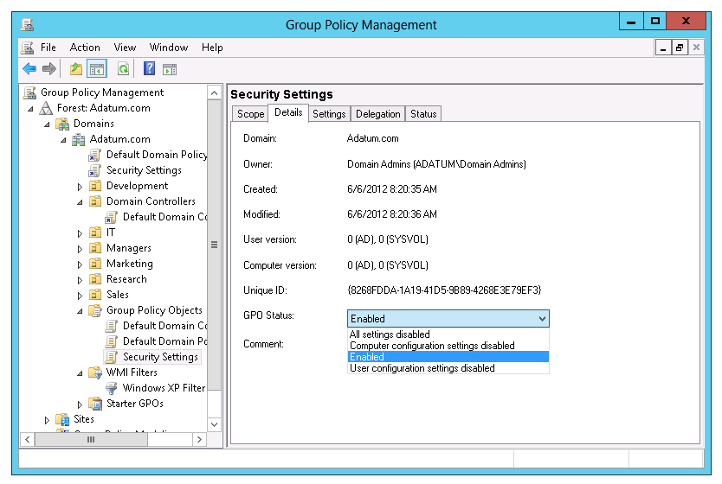
Enable and Disable GPOs and GPO Nodes
Notes:
In addition to explaining the settings in the GPO Status drop-down list, mention the slight performance benefits gained by specifically disabling nodes of GPOs that have no settings.
Discussion Prompt
Ask students to consider what scenarios might lead to disabling a GPO that has settings. Answers might include GPOs that configure disaster recovery settings or GPOs that configure strict lockdown in the case of a security incident. In other words, those GPOs that are disabled until needed.
20411D
4: Implementing a Group Policy Infrastructure

Slide 31
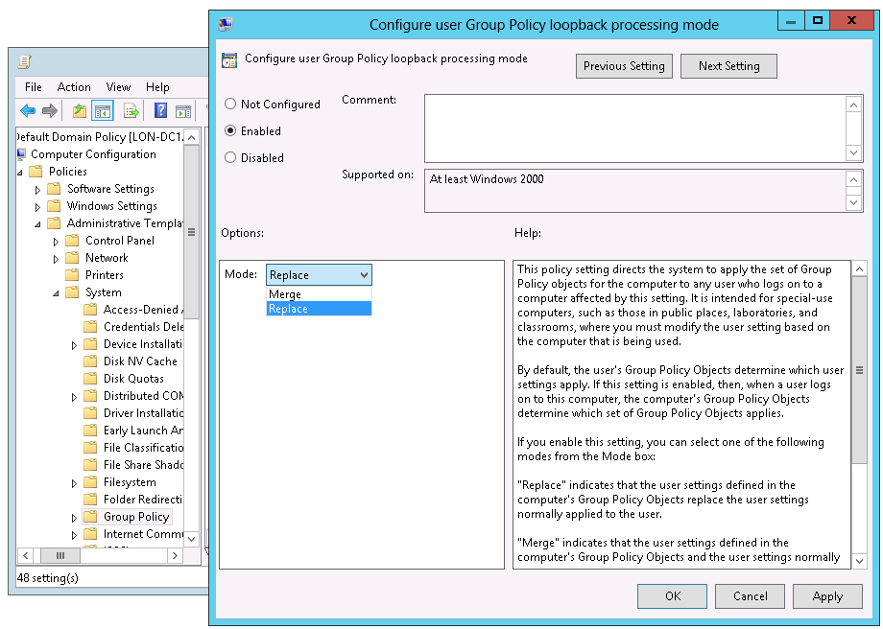
Loopback Policy Processing
Notes:
Both the user objects and computer objects can potentially have different applied Group Policy settings, depending on where each object resides in AD DS. Loopback processing ensures that the computer object’s policy takes precedence over the user object’s Group Policy settings.
Loopback processing operates by using the following two modes:
Merge. Merge mode applies the user’s normal Group Policy settings and the user settings that are associated with the location of the computer object. Both sets of policies will merge, but in the case of a conflict between settings, the computer loopback policy settings will apply.
Replace. Replace mode ignores the user’s normal Group Policy settings, and instead applies the user settings that are associated with the policy that delivered the loopback settings.
For example, a public access computer in the lobby might have a user policy that locks down the desktop completely and allows access only to certain software. Loopback processing in Replace mode would ensure that whoever logged on to the computer would be subject to those restrictions.
Give examples of when you might implement loopback processing.
20411D
4: Implementing a Group Policy Infrastructure

Slide 32
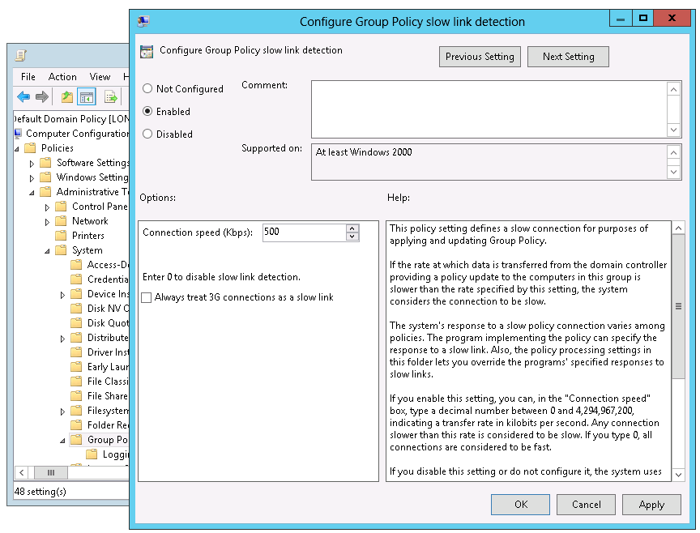
Strategies for Slow Links and Disconnected Systems
Notes:
Discuss the issues associated with slow links and disconnected systems. Make sure that students understand that, when a computer is disconnected, the settings that applied previously will continue to be in effect. There are several exceptions to this rule, notably that startup, logon, logoff, and shutdown scripts do not run when the system is disconnected.
20411D
4: Implementing a Group Policy Infrastructure

Slide 33
Identifying When Settings Become Effective
GPO replication must happen
Group changes must be replicated
Group Policy refresh must occur
User must log off or log on, or the computer must restart
Manual refresh
Most CSEs do not reapply unchanged GPO settings
Notes:
Use this slide to summarize the detail regarding when GPO settings actually take effect. Your students should be able to answer the question, “When I change a policy setting, when will that setting actually be applied to a user or computer?“
The student handbook contains a lot of good information that will allow you to talk about the slide and to answer questions from students.
Do not provide too much detail about the replication technologies themselves. Instead, point out that both the Group Policy container and Group Policy template must replicate to the domain controller from which a client obtains its policies, and that the Group Policy container and Group Policy template used to different replication technologies that are not always in sync.
Also emphasize the following to your students:
We highly recommend that organizations implement the Always Wait For Network At Startup And Logon policy setting. Without that, a change to a policy setting might take several logoff and logon or restart cycles before it takes effect, and there is no good way to predict the exact timing.
To truly manage the application of new policy settings, enable Always Wait For Network At Startup And Logon. Make sure that students understand that this does not slow down the startup or logon process significantly. Users will not complain that either is noticeably slower. Also, make sure that students understand that when a system is not connected to a network, it ignores this setting. This setting is not a problem for disconnected laptop users.
Users cannot change most policy settings, particularly managed policy settings. However, if users are administrators of their machines, it is possible for them to change some settings. Those changes will never be reverted to match the settings specified by the GPOs, because most client-side extensions will only reapply policy settings when a GPO has changed. The exceptions to this rule are security settings, which reapply every 16 hours, regardless of whether the GPO has changed. If an enterprise is concerned about enforcing its policy settings, and if it is possible for users to change those settings, then you should configure the client-side extensions to reapply policy settings even if the GPO has not changed. You can use Group Policy to configure the policy processing behavior of each CSE.
20411D
4: Implementing a Group Policy Infrastructure

Slide 34
Considerations For Managing Group Policy In A Multi-Domain Environment
Domain trust is required for simplifying multi-domain management of Group Policy
Use migration tables to automate the updates to UNC paths and security principals
Common GPO management techniques are valid across domains
Copy GPOs (Copy-GPO)
Import GPOs (Import-GPO)
Backing up and restoring (Backup-GPO, Restore-GPO)
Multi-domain environment may be made up of an internal test implementation of AD DS and a production implementation of AD DS
Notes:
Mention that Windows PowerShell has greatly simplified management of Group Policy in a multi-domain environment. An administrator can use a one-line Windows PowerShell command to copy all GPOs from one domain to another domain. If time allows, also discuss the ramifications of not using a migration table. What could administrators do instead – manually update Universal Naming Convention (UNC) paths and security principals for all GPOs?
20411D
4: Implementing a Group Policy Infrastructure

Slide 35
Lesson 4: Troubleshooting the Application of GPOs
Refreshing GPOs What is RSoP? Generate RSoP Reports Demonstration: Performing What-If Analysis with the Group Policy Modeling Wizard Examine Policy Event Logs
Notes:
In this lesson, you help students to understand that, in large networked environments, Group Policy application can sometimes be problematic. It is important that they know how to use available tools to solve Group Policy application issues.
20411D
4: Implementing a Group Policy Infrastructure

Slide 36
Refreshing GPOs
When you apply GPOs, remember that:
Computer settings apply at startup
User settings apply at logon
Polices refresh at regular, configurable intervals
Security settings refresh at least every 16 hours
Policies refresh manually by using:
The Gpupdate command
The Windows PowerShell cmdlet Invoke-GPUpdate
With the new Remote Policy Refresh feature in Windows Server 2012, you can remotely refresh policies
Notes:
Stress that changing the refresh interval might have performance effects on both the client computer and the network, and therefore should be tested before implementation.
Ensure that students understand the idea of users logging on with cached credentials, and the effect this has on Group Policy settings.
Point out the new Remote Policy Refresh feature of Windows Server 2012.
20411D
4: Implementing a Group Policy Infrastructure

Slide 37




What is RSoP?
Windows Server 2012 provides the following tools for performing RSoP analysis:
GPO1
Local
GPO2
Site
GPO3
The Group Policy Results Wizard
The Group Policy Modeling Wizard
GPResult.exe
Domain
GPO4
OU
GPO5
OU
OU
Notes:
Use this topic to introduce the term, concepts, and tools of RSoP. Remind students how complex it can become to evaluate an RSoP, with factors including inheritance, filters, loopback, the interaction between GPOs in client-side extensions, and the large number of possible policy settings. Help students understand that RSoP is both a descriptor, meaning the end result of policy application, and the name of a collection of tools and processes.
20411D
4: Implementing a Group Policy Infrastructure

Slide 38
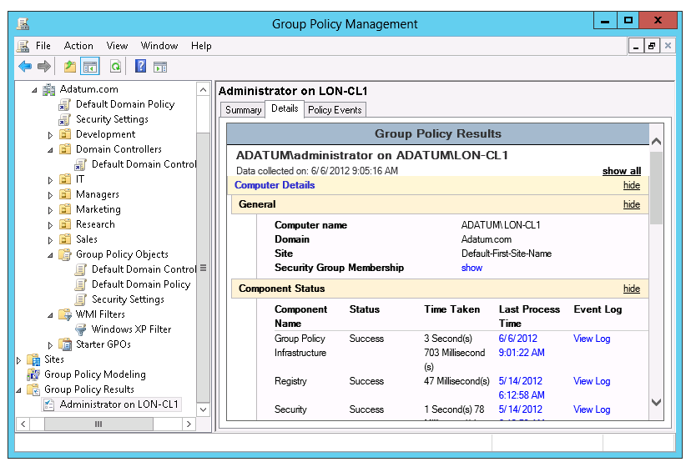
Generate RSoP Reports
Notes:
Talk in detail about RSoP reports, preferably with demonstrations. Ensure that students understand how to generate, interpret, and save RSoP reports that are created by the Group Policy Results Wizard in the Group Policy Management Editor console or by the GPResult command.
Emphasize the critical importance of RSoP reports in analyzing and troubleshooting Group Policy application in an enterprise.
20411D
4: Implementing a Group Policy Infrastructure

Slide 39
Demonstration: Performing What-If Analysis with the Group Policy Modeling Wizard
In this demonstration, you will see how to:
Use GPResult.exe and the Group Policy Reporting Wizard
Use the Group Policy Modeling Wizard
Notes:
Emphasize that the Group Policy Modeling Wizard is not reporting actual application of Group Policy, but rather, is analyzing and reporting anticipated Group Policy application.
Ask students what scenarios would lend themselves to using Group Policy Modeling. Among the answers should be scenarios in which users or computers will be moved, scenarios in which group memberships will be changed to evaluate the potential changes to their configuration from Group Policy. Also, you can use modeling to evaluate the impact of a new GPO prior to rolling it into production.
When you are finished with this demonstration, you can revert all virtual machines.
Preparation Steps
The required virtual machine, 20411D-LON-DC1 already should be running after the preceding demonstration.Demonstration Steps
Use GPResult.exe to create a report
On LON-DC1, right-click the Start icon, and then click Windows PowerShell (Admin).
In the Windows PowerShell window, type cd desktop, and then press Enter.
In the Windows PowerShell window, type the following, and press Enter:
GPResult /r
Review the output in the Windows PowerShell window.
In the Windows PowerShell window, type the following, and then press Enter:
GPResult /h results.html
Close the Windows PowerShell window, and then double-click the results.html file on the desktop.
In the Internet Explorer® window, view the results of the report.
Close Internet Explorer.
20411D
4: Implementing a Group Policy Infrastructure
(More notes on the next slide)

Slide 40
Notes:
Use the Group Policy Reporting Wizard to create a report
Open Server Manager, click Tools, and then click Group Policy Management.
In the Group Policy Management window, right-click Group Policy Results, and then click Group Policy Results Wizard.
In the Group Policy Results Wizard, click Next.
On the Computer Selection page, click Next.
On the User Selection page, click Next.
On the Summary of Selections page, click Next.
On the Completing the Group Policy Results Wizard page, click Finish.
Review the Group Policy results.
Under the Group Policy Results folder, right-click the Administrator on LON-DC1 report, and then click Save Report.
In the Save GPO Report dialog box, click Desktop, and then click Save.
Use the Group Policy Modeling Wizard to create a report
Right-click the Group Policy Modeling folder, and then click Group Policy Modeling Wizard.
In the Group Policy Modeling Wizard, click Next.
On the Domain Controller Selection page, click Next.
On the User and Computer Selection page, under User information, click User, and then click Browse.
In the Select User dialog box, type Ed Meadows, and then click OK.
Under Computer information, click Browse.
(More notes on the next slide)
20411D
4: Implementing a Group Policy Infrastructure

Slide 41
Notes:
In the Choose Computer Container dialog box, expand Adatum, click IT, and then click OK.
On the User and Computer Selection page, click Next.
On the Advanced Simulation Options page, click Next.
On the Alternate Active Directory Paths page, click Next.
On the User Security Groups page, click Next.
On the Computer Security Groups page, click Next.
On the WMI Filters for Users page, click Next.
On the WMI Filters for Computers page, click Next.
On the Summary of Selections page, click Next.
On the Completing Group Policy Modeling Wizard page, click Finish.
Review the report.
Close all open windows.
After the demonstration, revert all of the virtual machines used for the demonstrations.
(More notes on the next slide)
20411D
4: Implementing a Group Policy Infrastructure

Slide 42
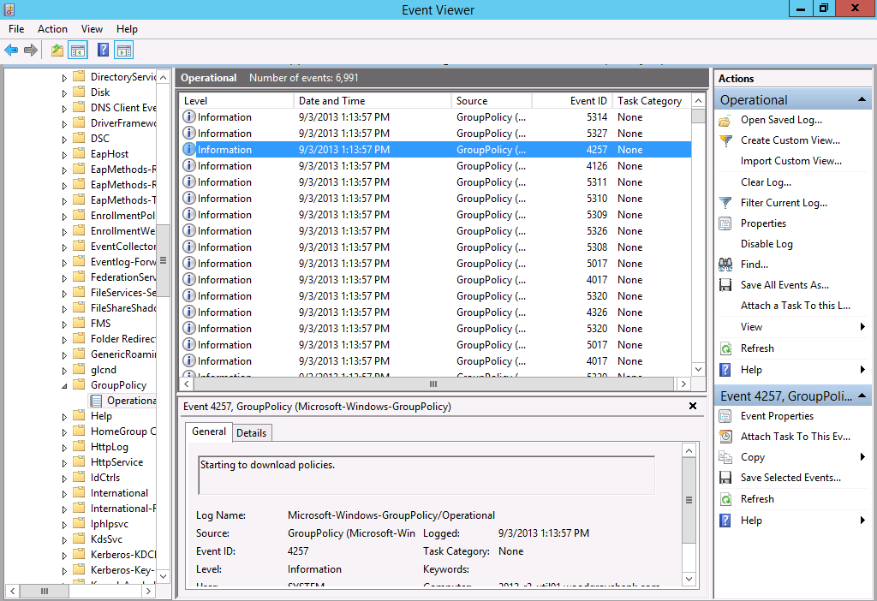
Examine Policy Event Logs
Notes:
Consider demonstrating the three major logs in which Group Policy events can be found.
Also, point out that RSoP reports also expose Group Policy events, particularly in the Advanced view.
Mention that the Group Policy Operational log is a great way to learn about exactly how Group Policy is applied in the Windows® operating system. You can trace every step of the application of Group Policy that the previous lesson described.
20411D
4: Implementing a Group Policy Infrastructure

Slide 43
Lab: Implementing a Group Policy Infrastructure
Exercise 1: Creating and Configuring GPOs Exercise 2: Managing GPO Scope Exercise 3: Verifying GPO Application Exercise 4: Managing GPOs
Logon Information
Virtual machines: 20411D-LON-DC1, 20411D-LON-CL1
User name: Adatum\Administrator
Password: Pa$$w0rd
Estimated Time: 90 minutes
Notes:
Exercise 1: Creating and Configuring GPOs
You have been asked to use Group Policy to implement standardized security settings to lock computer screens when users leave computers unattended for 10 minutes or more. You also have to configure a policy setting that will prevent users from running the Notepad application on local workstations.
Exercise 2: Managing GPO Scope
After some time, you have been made aware that a critical application that the Research Engineering team uses is failing when the screen saver starts. You have been asked to prevent the GPO setting from applying to any member of the Engineering security group. You also have been asked to configure conference room computers to be exempt from corporate policy. However, they always must have a 45-minute screen saver timeout applied.
Exercise 3: Verifying GPO Application
After creating the required policies, you need to evaluate the RSoPs for the users in your environment to ensure that the Group Policy infrastructure is healthy, and that all policies apply as intended.
Exercise 4: Managing GPOs
You must back up all critical GPOs. You use the Group Policy Management backup feature to back up the ADATUM Standard GPO.
20411D
4: Implementing a Group Policy Infrastructure

Slide 44
Lab Scenario
A. Datum Corporation is a global engineering and manufacturing company with its head office in London, England. An IT office and a data center are located in London to support the London office and other locations. A. Datum recently deployed a Windows Server 2012 server and client infrastructure.
You have been asked to use Group Policy to implement standardized security settings to lock computer screens when users leave computers unattended for 10 minutes or more. You also have to configure a policy setting that will prevent
Notes:
20411D
4: Implementing a Group Policy Infrastructure

Slide 45
Lab Scenario
access to certain programs on local workstations.
After some time, you have been made aware that a critical application fails when the screens saver starts, and an engineer has asked you to prevent the setting from applying to the team of Research engineers that uses the application every day. You also have been asked to configure conference room computers to use a 45-minute timeout.
After creating the policies, you need to evaluate the RSoPs for users in your environment to ensure that the Group Policy infrastructure is optimal and that all policies apply as intended.
Notes:
20411D
4: Implementing a Group Policy Infrastructure

Slide 46
Lab Review
Which policy settings are already being deployed by using Group Policy in your organization? Many organizations rely heavily on security group filtering to scope GPOs, rather than linking GPOs to specific OUs. In these organizations, GPOs typically are linked very high in the Active Directory logical structure—to the domain itself or to a first-level OU. What advantages do you gain by using security group filtering rather than GPO links to manage a GPO’s scope?
Notes:
Question
Which policy settings are already being deployed by using Group Policy in your organization?
Answer
Answers will vary.
Question
Many organizations rely heavily on security group filtering to scope GPOs, rather than linking GPOs to specific OUs. In these organizations, GPOs typically are linked very high in the Active Directory logical structure—to the domain itself or to a first-level OU. What advantages do you gain by using security group filtering rather than GPO links to manage a GPO’s scope?
Answer
The fundamental problems of relying on OUs to scope the application of GPOs is that an OU is a fixed, inflexible structure within AD DS, and a single user or computer can only exist within one OU. As organizations grow larger and more complex, configuration requirements are difficult to match in a one-to-one relationship with any container structure. With security groups, a user or computer can exist in as many groups as necessary, and you can add or remove them easily without affecting the security or management of the user or computer account.
Question
Why might it be useful to create an exemption group—a group that is denied the Apply Group Policy permission—for every GPO that you create?
Answer
There are very few scenarios in which you can be guaranteed that all of the settings in a GPO will always need to apply to all users and computers within its scope. By having an exemption group, you will always be able to respond to situations in which a user or computer must be excluded. This can also help in troubleshooting compatibility and functionality problems. Sometimes, specific GPO settings can interfere with the functionality of an application. To test whether the application works on a clean installation of the Windows operating system, you might need to exclude the user or computer from the scope of GPOs, at least temporarily for testing.
20411D
4: Implementing a Group Policy Infrastructure
(More notes on the next slide)

Slide 47
Lab Review
Why might it be useful to create an exemption group—a group that is denied the Apply Group Policy permission—for every GPO that you create? Do you use loopback policy processing in your organization? In which scenarios and for which policy settings can loopback policy processing add value? In which situations have you used RSoP reports to troubleshoot Group Policy application in your organization? In which situations have you used, or might you anticipate using, Group Policy Modeling?
Notes:
Question
Do you use loopback policy processing in your organization? In which scenarios and for which policy settings can loopback policy processing add value?
Answer
Answers will vary. Scenarios could include in conference rooms and kiosks, in Virtual Desktop Infrastructures, and in other standard environments.
Question
In which situations have you used RSoP reports to troubleshoot Group Policy application in your organization?
Answer
The correct answer will be based on your own experience and situation.
Question
In which situations have you used, or might you anticipate using, Group Policy Modeling?
Answer
The correct answer will be based on your own experience and situation.
(More notes on the next slide)
20411D
4: Implementing a Group Policy Infrastructure

Slide 48
Module Review and Takeaways
Review Question(s) Tools Common Issues and Troubleshooting Tips
Notes:
Review Question(s)
Question
You have assigned a logon script to an OU via Group Policy. The script is in a shared network folder named Scripts. Some users in the OU receive the script, whereas others do not. What might be the possible causes?
Answer
Security permissions might be a problem. If some users do not have read access to the shared network folder where the scripts are stored, they will not be able to apply policy. Also, security filtering on GPOs might be the cause for this problem.
Question
What GPO settings apply across slow links by default?
Answer
Registry policy and Security policy apply even when a slow link is detected. You cannot change this setting.
Question
You need to ensure that a domain-level policy is enforced, but the Managers global group needs to be exempt from the policy. How would you accomplish this?
Answer
Set the link to enforce at the domain level, and use security group filtering to deny Apply Group Policy permission to the Administrators group.
20411D
4: Implementing a Group Policy Infrastructure
(More notes on the next slide)

Slide 49
Notes:
Tools
Common Issues and Troubleshooting Tips
Common Issue: Group Policy settings are not applied to all users or computers in an OU where a GPO is applied
Troubleshooting Tip: Check security filtering on the GPO
Check WMI filters on the GPO
Common Issue: Group Policy settings sometimes need two restarts to apply
Troubleshooting Tip: Enable the Always Wait For Network At Startup And Logon policy setting
20411D
4: Implementing a Group Policy Infrastructure

